Slide 1
Computer Architecture & Organization
Unit-1

Slide 2
How is a Computer defined?
  The Computer comes from word compute which means to calculate. It is considered to be calculating device. It operates on data. Computer can store, process, retrieve data. That’s why it is also called data processor. This activity of processing data is called data processing.
    1. Accepts data such as raw facts, figures, and symbol
    2. Processes data into information (Data that is organized,
    meaningful, and useful )
    3. Produces and stores results
    OR
  Electronic device operating under the control of instructions stored in its own memory.

Slide 3
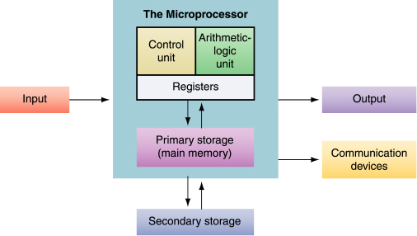
Block diagram of Digital Computer

Slide 4
Digital Computers
System that perform various computational tasks.
Digital implies that information is represented by variables that take a limited number of discrete values. For example decimal digits 0,1,2,3………9.
Digital computers use binary number system which has two digits 0 and 1. A binary digit is called a bit.

Slide 5
Computer System is subdivided among two functional entities:
Hardware
Software

Slide 6
Computer Hardware
A computer's hardware consists of electronic and electromechanical devices; the parts you can see and touch.
The term "device" refers to any piece of hardware used by the computer, such as a keyboard, monitor, modem, mouse, etc.

Slide 7
Computer Software
  Software – also called programs – consists of organized sets of instructions for controlling the computer.
  Some programs exist for the computer's use, to help it manage its own tasks and devices.
  Other programs exist for the user, and enable the computer to perform tasks for you, such as creating documents.

Slide 8
  Software is a set of electronic instructions that tells the computer how to do certain tasks. A set of instructions is often called a program.
  When a computer is using a particular program, it is said to be running or executing the program.
  The two most common types of programs are system software and application software.

Slide 9
What is System software?
System software exists primarily for the computer itself, to help the computer perform specific functions.
One major type of system software is the operating system (OS). All computers require an operating system.
The OS tells the computer how to interact with the user and its own devices.
Common operating systems include Windows, the Macintosh OS, OS/2, and UNIX .
Communication Software
Utility program

Slide 10
What is application software?
Application software tells the computer how to accomplish tasks the user requires, such as creating a document or editing a graphic image.
Some important kinds of application software are:
Word processing programs Spreadsheet software
Database management Presentation programs
Graphics programs Networking software
Internet applications

Slide 11
Computer Organization
Computer Organization is concerned with the way the hardware components operate and the way they are concerned together to form the computer system.
Computer Design is concerned with the determination of what hardware should be used & how the parts should be connected. This aspect of computer hardware is referred to as Computer Implementation.

Slide 12
Computer Architecture: This is concerned with the structure and behavior of the computer as seen by the user. It includes the information formats, the instruction set and addressing modes for accessing memory.

Slide 13
Logic Gates
The two states represent a binary variable is TRUE(1) or FALSE(0).
In a digital computer a signal of 3 volts represents binary 1 and 0.5 volts represents binary 0.

Slide 14
The manipulation of binary information is done by logic circuits called gates.
The input-output relationship of the binary variables for each gate can be represented in tabular form by a truth table.

Slide 15
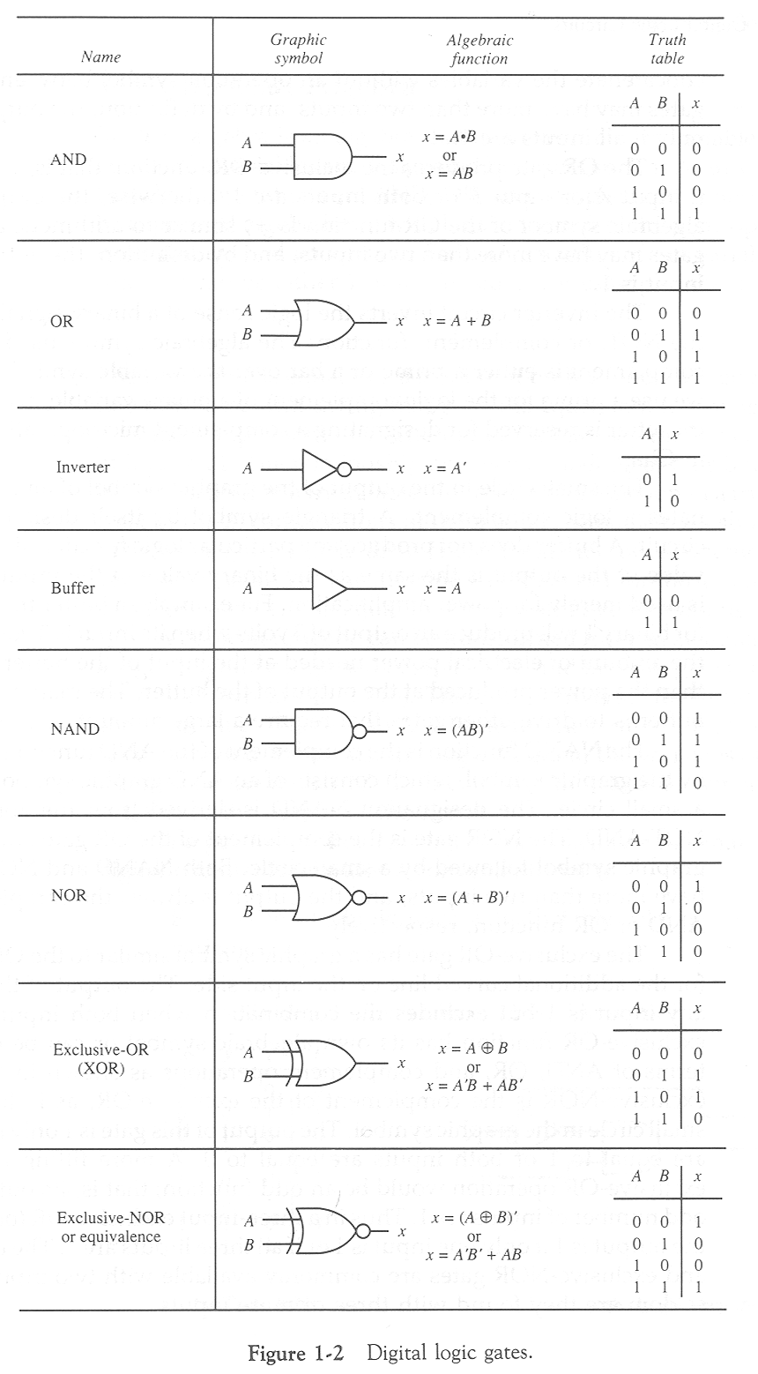

Slide 16
Number System

Slide 17
You may regard each digit as a box that can hold a number.
In the Decimal system, there are ten different numbers that can enter the digit box: "0", "1", "2", "3", "4", "5", "6", "7", "8", "9".
In the Binary system, there can be only two choices for this number -- either a "0" or a "1".
In the Octal system, there can be eight possibilities: "0", "1", "2", "3", "4", "5", "6", "7".
In the Hexadecimal system, we allow 16 numbers: "0", "1", "2", "3", "4", "5", "6", "7", "8", "9", "A", "B", "C", "D", "E", and "F".

Slide 18
A number system of base, or radix, r is a system that uses distinct symbols for r digits.
Numbers are represented by a string of digit symbols.
To determine the quantity that the number represents, it is necessary to multiply each digit by an integer power of r and then form the sum of all weighted digits.

Slide 19
Decimal Number System
The Decimal Number System uses base 10.
It includes the digits from 0 through 9.
"0", "1", "2", "3", "4", "5", "6", "7", "8", "9".
In reality, however, the number 123 represents:
  1 * 10² + 2 * 10¹ + 3 * 10⁰ =
  1 * 100 + 2 * 10 + 3 * 1 =
  100 + 20 + 3 =
  123

Slide 20
For example, the value 725.1 is represented as follows:
  7 * 10² + 2 * 10¹ + 5 * 10⁰ + 1 * 10⁻¹ =
  7 * 100 + 2 * 10 + 5 * 1 + 1 * 0.1 =
  700 + 20 + 5 + 0.1 =
  725.1
That is 7 hundreds + 2 tens + 5 units + 1 tenths

Slide 21
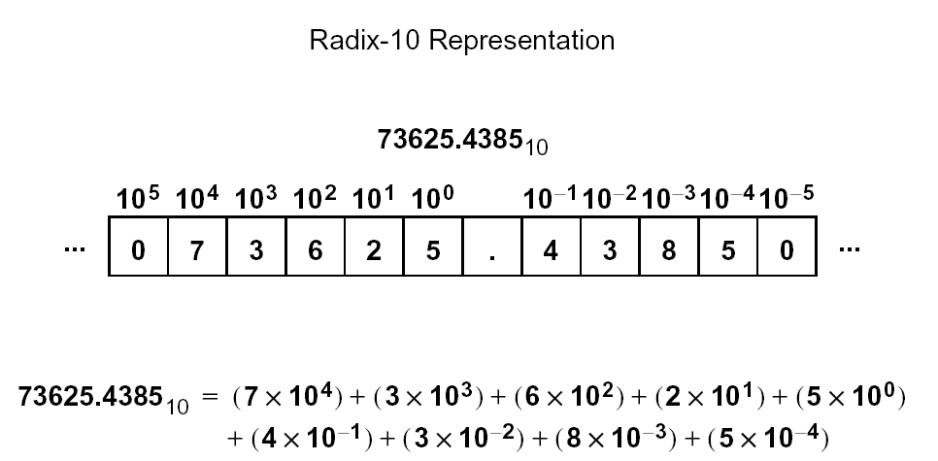

Slide 22
Binary Number System
Binary number system uses the radix 2.
The two digit symbols used are 0 and 1.
The string of (1010)₂ represents:
1*2³ + 0*2² + 1*2¹ + 0*2⁰ =
1 * 8 + 0 * 4 + 1 * 2 + 0 * 1 =
8 + 0 + 2 + 0 = 10
(1010)₂ = (10)₁₀
_{Binary to Decimal Conversion}

Slide 23
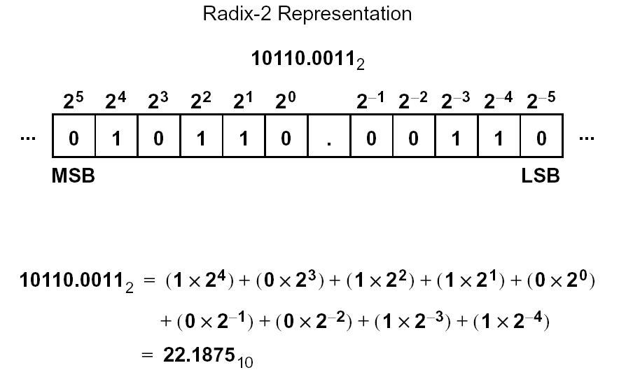

Slide 24
Binary to Decimal Conversion
Convert binary number 1010.1011 into decimal number.
= (1010.1011)₂
= 1x2³+0x2²+1x2¹+0x2⁰+1x2⁻¹+0x2⁻²+1x2⁻³+1x2⁻⁴
= (8+0+2+0)+(0.5+0+0.125+0.0625)
= (10.6875)₁₀

Slide 25
Bit & Byte
Computer uses the binary system. Any physical system that can exist in two distinct states (e.g., 0-1, on-off, hi-lo, yes-no, up-down, north-south, etc.) has the potential of being used to represent numbers or characters.
A binary digit is called a bit. There are two possible states in a bit, usually expressed as 0 and 1.
A series of eight bits strung together makes a byte, much as 12 makes a dozen. With 8 bits, or 8 binary digits, there exist 2^8=256 possible combinations.
For eg. 00000000 ( 0), 00000001 ( 1),
00000010 ( 2), 00000011 ( 3) ……..

Slide 26
The classification of individual bits into larger groups are generally referred to by the following more common names of:
Number of Binary Digits (bits) | Common Name
1 | Bit
4 | Nibble
8 | Byte
16 | Word
32 | Double Word
64 | Quad Word

Slide 27
Why is Binary number system used in Computers?
The circuits & switches in a computer have only two states, either on or off, which are represented by 1 & 0.
Handling of two digits, that is, 1 & 0 is simpler, cheaper and more reliable.
Every operation that can be performed by decimal number system can also be done using binary number system, so it does not create any problem.

Slide 28
Decimal to Binary Conversion
For e.g.. (11.8125)₁₀ = (?)₂
First, take the integer part 11 and perform successive division by 2
Remainder
2
11
2
1
LSB (Least Significant bit)
5
2
2
1
2
1
0
0
1
MSB (Most Significant bit)
11₁₀ = 1011₂

Slide 29
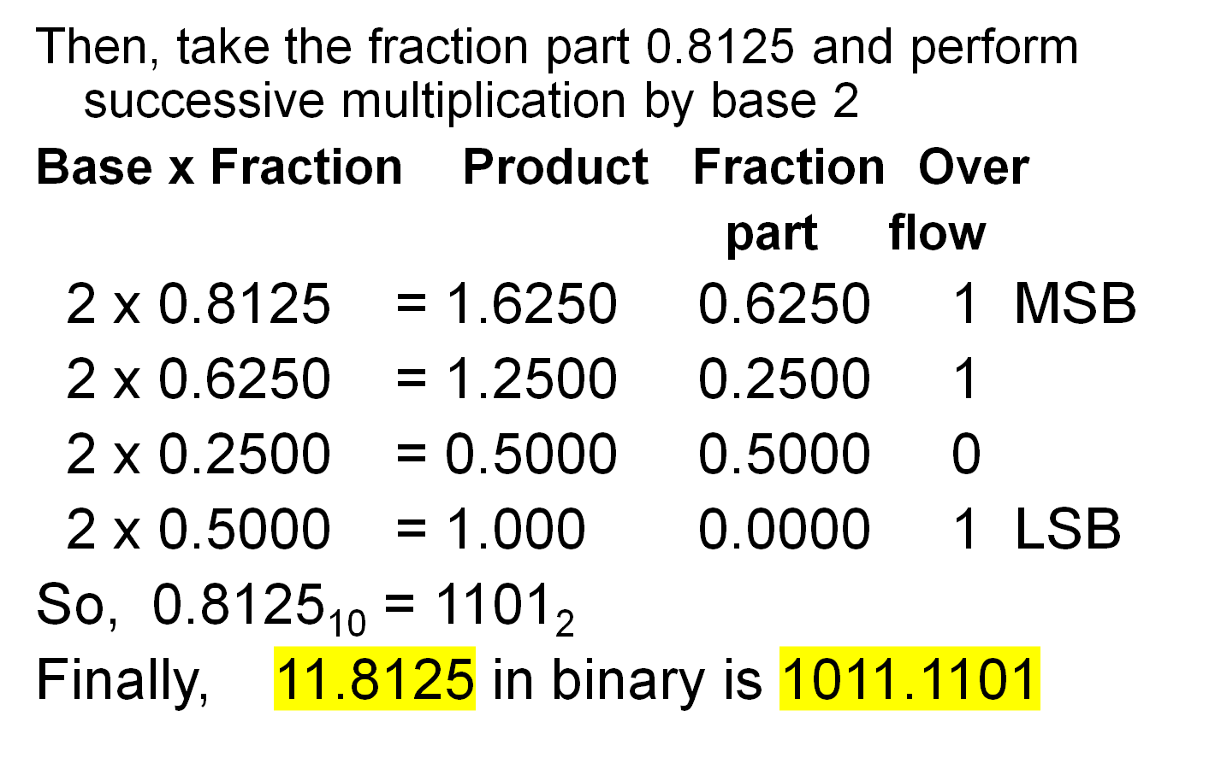

Slide 30
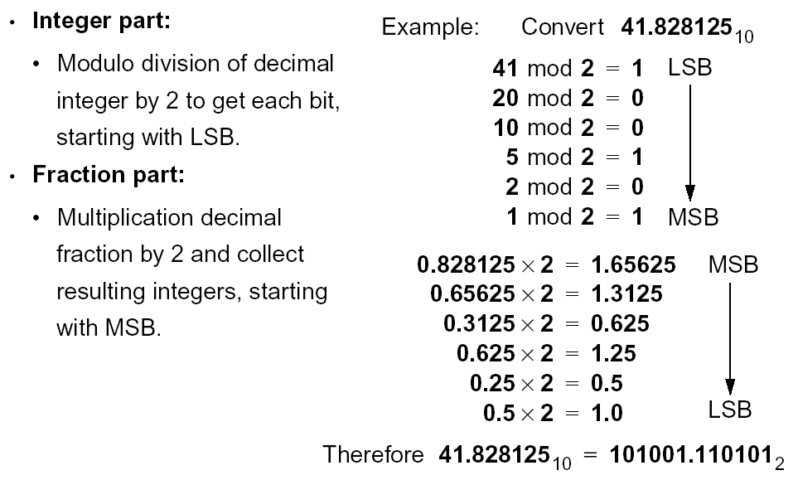

Slide 31
Practice Questions
Make a table and write binary numbers from 0 to 20.
(258.132)₁₀ = (_________)₂
(1100.1010)₂ = (_______)₁₀
16-10000
17- 10001
18- 10010
19- 11001

Slide 32
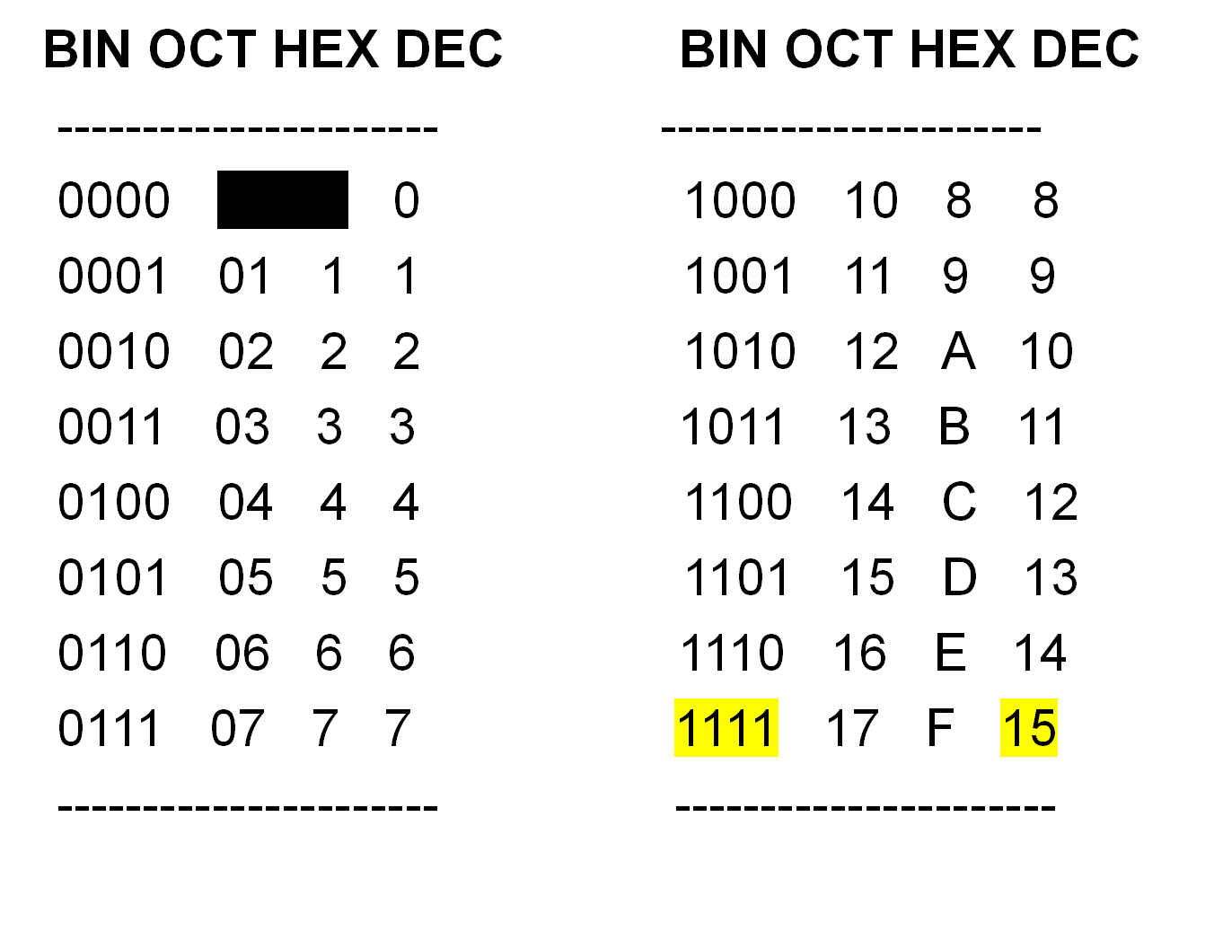

Slide 33
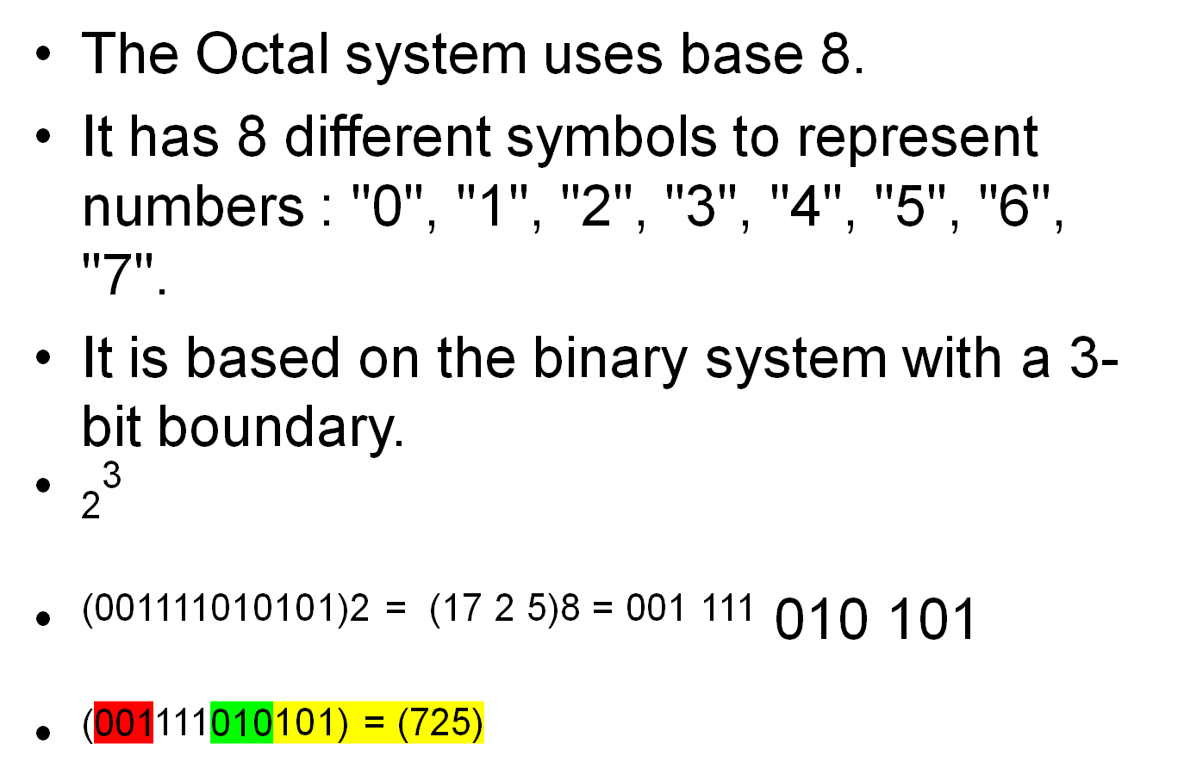
Octal Number System

Slide 34
Octal to Decimal Conversion
(30.67)₈ = (?)₁₀
(30)₈ = 3 x 8¹ + 0 x 8⁰
= 3 x 8 + 0 = (24)10
Decimal to Octal Conversion
(543.26)10 = (1037)8
Remainders
8
543
8
67
7
LSB
8
8
3
8
1
0
0
1
MSB

Slide 35
Base x Fraction Product Fraction Over
part flow
8 x 0.26 = 2.80 0.08 2 MSB
8 x 0.08 = 0.64 0.64 0
8 x 0.64 = 5.12 0.12 5
8 x 0.12 = 0.96 0.96 0 LSB
So finally, 543.26₁₀ = 1037.205₈

Slide 36
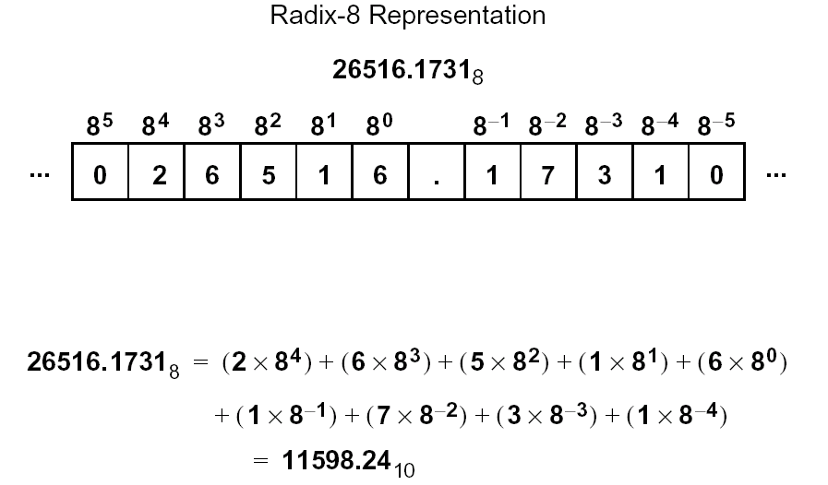

Slide 37
Binary to Octal Conversion
It is easy to convert from an integer binary
number to octal. This is accomplished by:
1.)Break the binary number into 3-bit sections from the LSB to the MSB.
2.)Convert the 3-bit binary number to its octal equivalent.
For example, the binary value 1010111110110010
will be written:
001 010 111 110 110 010
1 2 7 6 6 2
So, (1010111110110010)₂ = (127662)₈

Slide 38
Octal to Binary Conversion
1.) Convert the decimal number to its 3-bit binary equivalent.
2.) Combine the 3-bit sections by removing the spaces.
For example, the octal value 127662 will be written:
1 2 7 6 6 2
001 010 111 110 110 010
So, (127662)₈ ₌ (1010111110110010)₂

Slide 39
Hexadecimal Number System
A big problem with the binary system is verbosity. To represent the value 202 requires eight binary digits.
The decimal version requires only three decimal digits and, thus, represents numbers much more compactly than does the binary numbering system. This fact was not lost on the engineers who designed binary computer systems.
When dealing with large values, binary numbers quickly become too unwieldy. The hexadecimal (base 16) numbering system solves these problems.

Slide 40
Hexadecimal numbers offer the two features:
1.) hex numbers are very compact
2.) it is easy to convert from hex to binary and binary to hex.
In Assembly Language programming, most assemblers require the first digit of a hexadecimal number to be 0, and we place an H at the end of the number to denote the number base. For e.g. 00H, 01H, 02H, 0AH, 0FBH…….
The Hexadecimal Number System:
  uses base 16
  includes only the digits 0 through 9 and the letters “A”, “B”, “C”, “D”, “E”, and “F”.

Slide 41
Binary to Hex Conversion
It is easy to convert from an integer binary number to hex. This is accomplished by:
1.) Break the binary number into 4-bit section from
the LSB to the MSB.
2.) Convert the 4-bit binary number to its Hex
equivalent.
For example, the binary value 1010111110110010 will be written:
1010 1111 1011 0010
A F B 2

Slide 42
Hex to Binary Conversion
For example, the hex value 0AFB2 will be written:
0 A F B 2
0000 1010 1111 1011 0010
Hex to Decimal Conversion
(4AB.2)₁₆ = (?)₁₀
= 4 x 16² + 10 x 16¹ + 11 x 16⁰ + 2 x 16⁻¹
= 4 x 256 + 10 x 16 + 11 x 1 + 0.125
= 1024 + 160 + 11 + .125 = (1195.125)₁₀

Slide 43
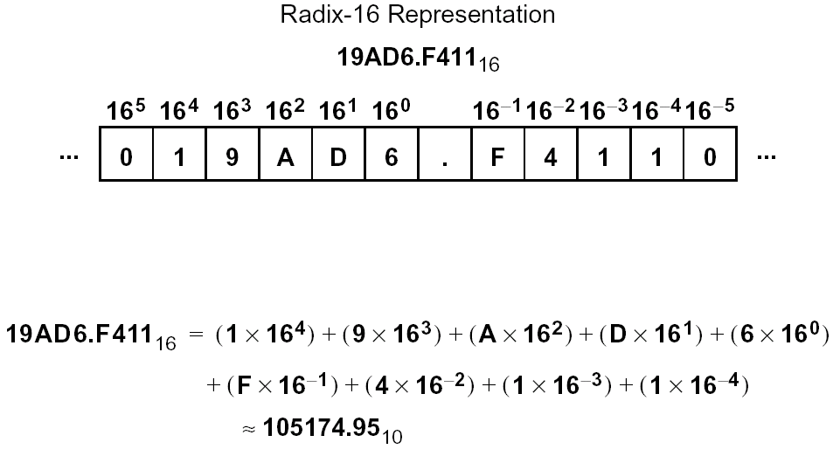

Slide 44
Practice
2 A F 4 . 5 6 =(0010101011110100.01010110)2
0001 0011 1010. 1101 0100
= (13A.D4)16
(46.23)10= (00101110.001110101)2 =(2E.3AE)16 = (056.16)8

Slide 45
Binary Arithmetic's
Binary Addition
0 + 0 = 0
0 + 1 = 1
1 + 0 = 1
1 + 1 = 10 or 0 plus a carry over of 1
When 1 is combined with 1 we get 2 which is 10 in binary or we can say a 0 with 1 carry.

Slide 46
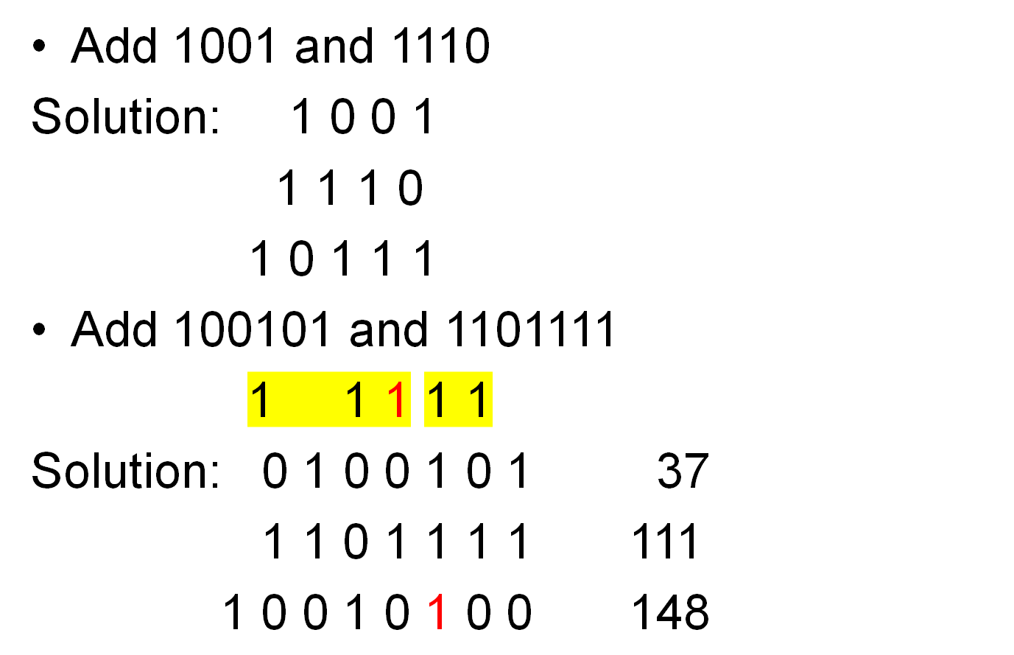

Slide 47
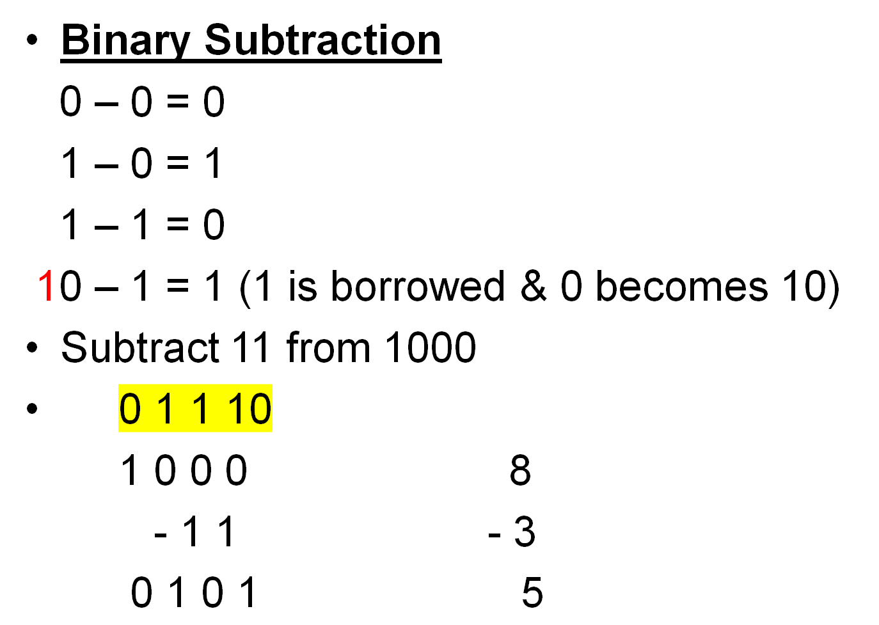

Slide 48
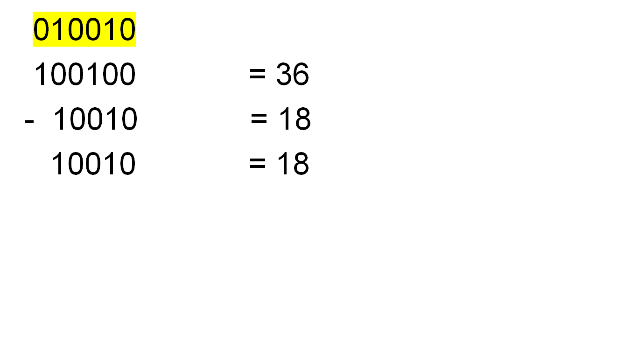
Subtraction

Slide 49
Binary Multiplication
Rules:
1 x 0 = 0
0 x 1 = 0
1 x 1 = 1
For eg: 1001 = 9
x 10 = 2
0000
1001x
10010 = 18

Slide 50
Binary Division
The 3 main rules of the binary division include:
1÷1 = 1
1÷0 = 0
0÷1 = Meaningless
0÷0 = Meaningless

Slide 51
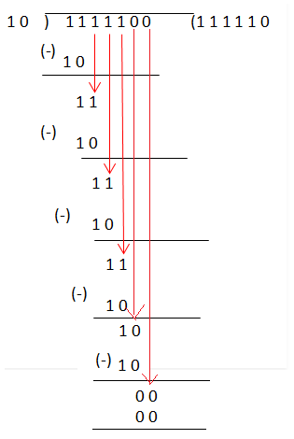
Division

Slide 52
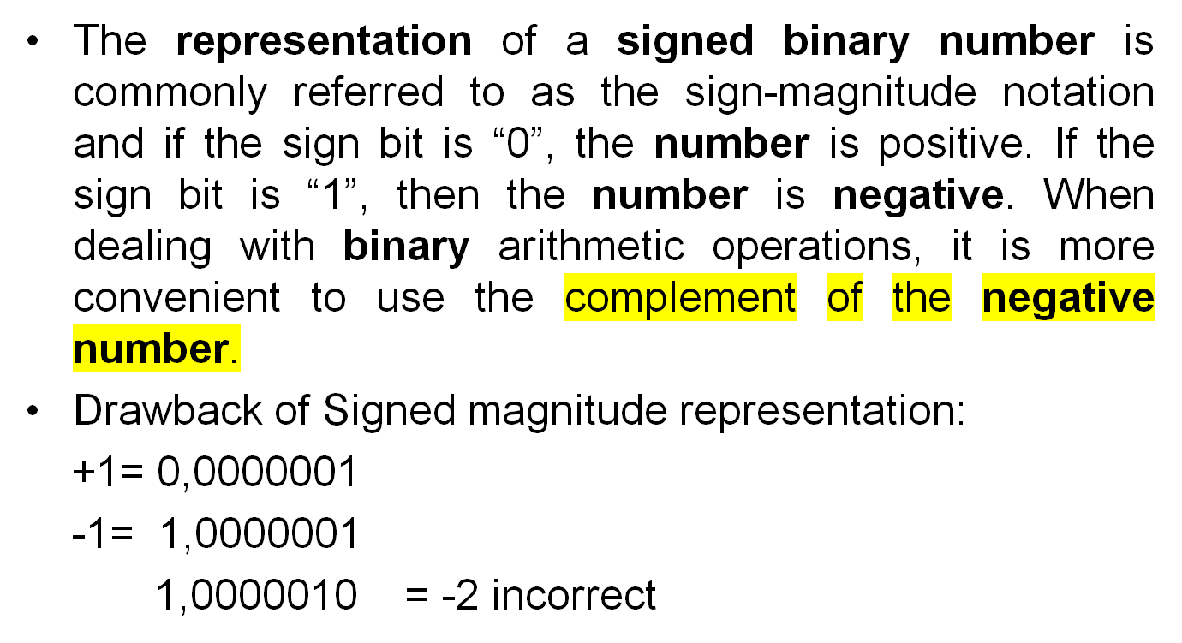
Signed binary Numbers

Slide 53
Complement's

Slide 54
Used in digital computers for simplifying the subtraction operation and for logical manipulation.
There are two types of complement’s:
1.) r’ s complement = 2’s
2.) (r – 1)’ s complement = 1’s
If base r is substituted, than we get 1’s & 2’s complement for binary numbers

Slide 55
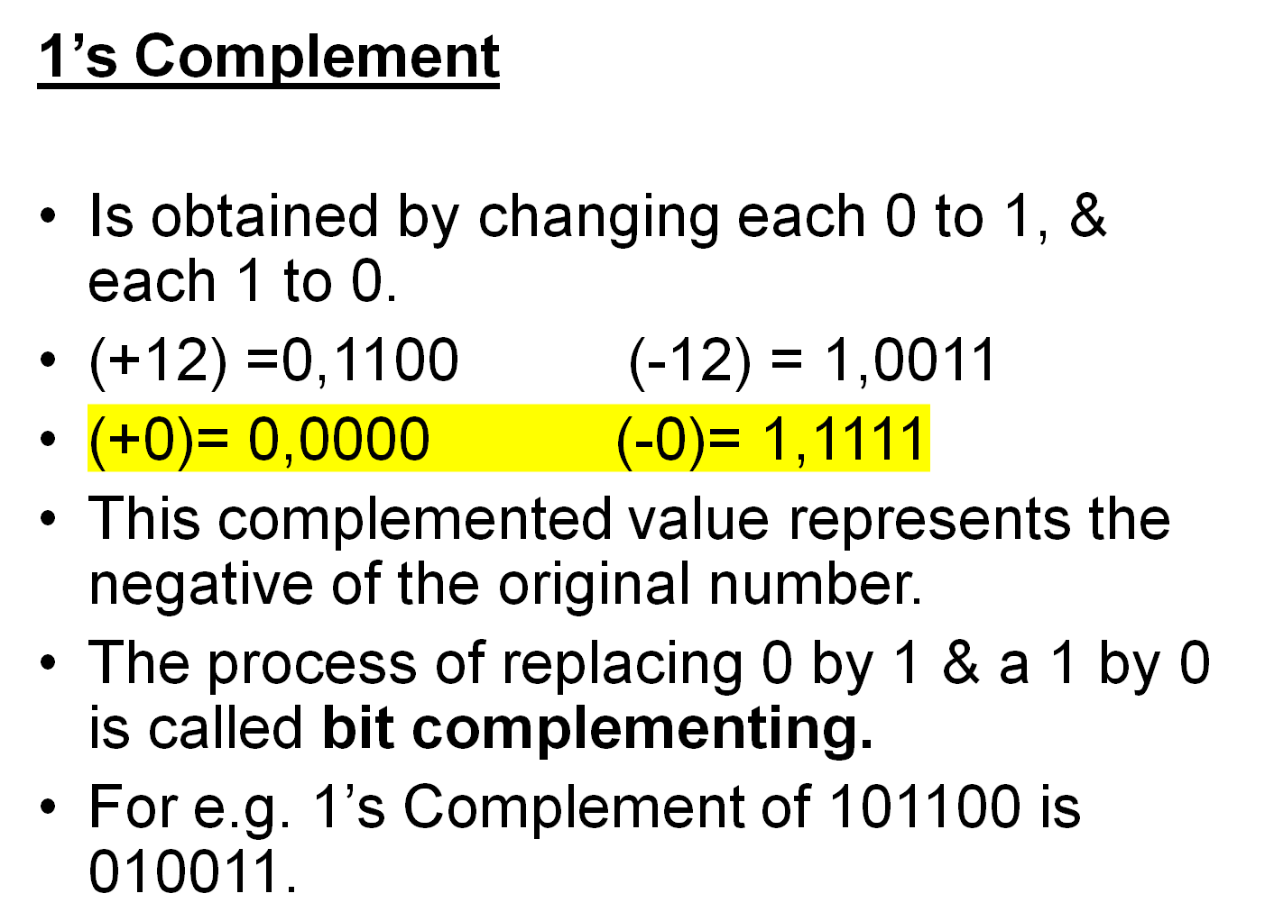

Slide 56
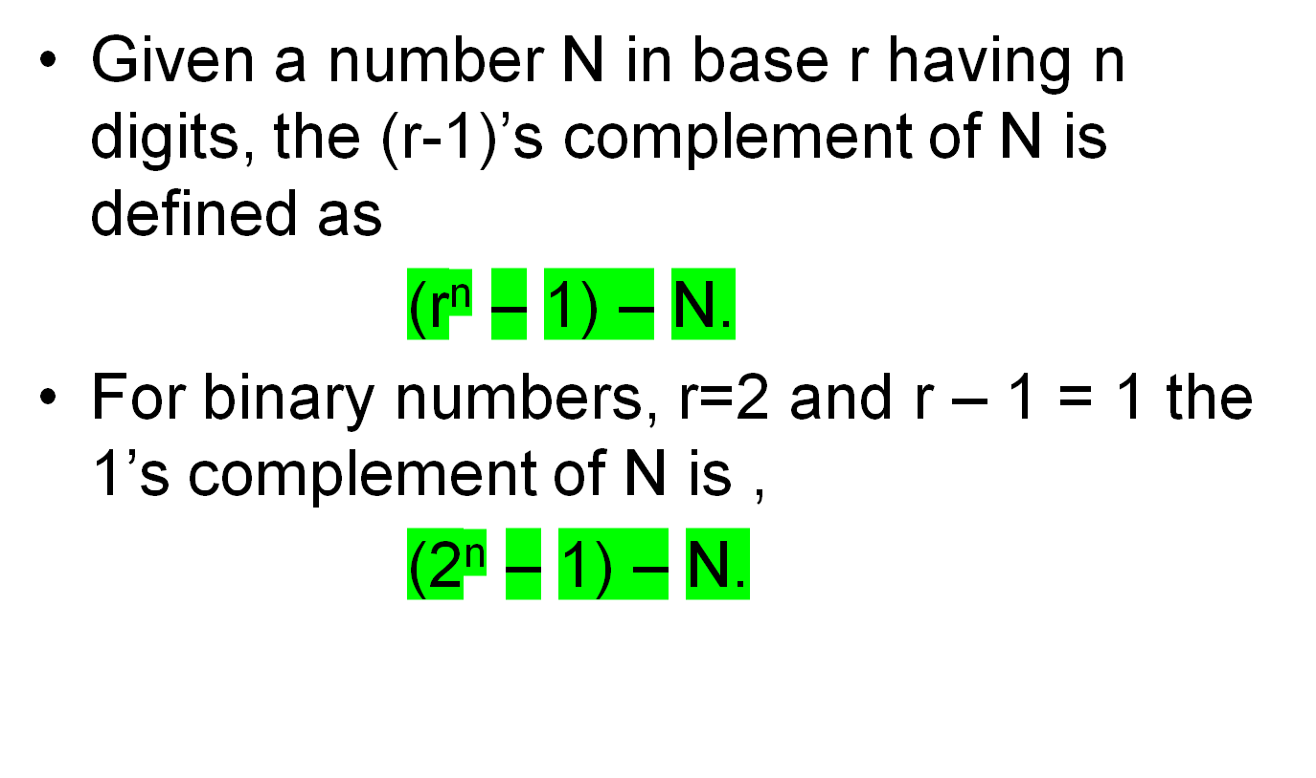

Slide 57
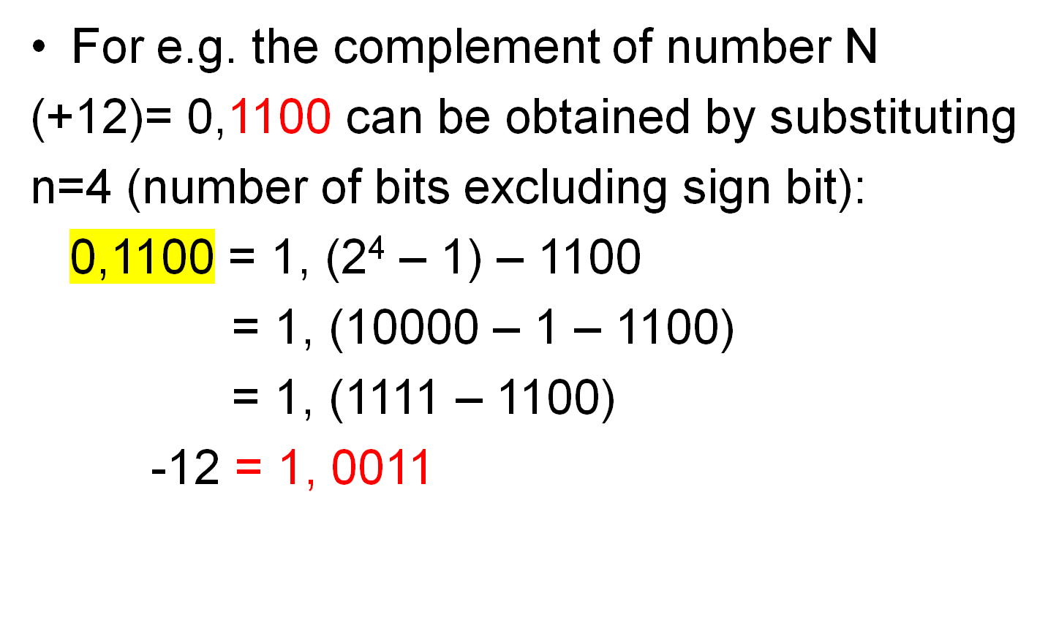

Slide 58
Addition & Subtraction in 1’s Complement
+4 = 0,0100
+9 = 0,1001
+13= 0,1101
But if the sum exceeds 15 then 4-bit addition will give incorrect results.
+9 = 0,00001001
+10 =0,00001010
=0,00010011 (which is not equal to 19)

Slide 59
For adding +9 and +10 in 8-bits
+9 = 0,0001001
+10 = 0,0001010
= 0, 0010011 (which is equal to +19)
Main advantage of 1’s complement is that the subtraction can be done as addition of the 1’s complement of the number. For e.g
21₁₀ – 7₁₀ = 21 + (-7)

Slide 60
21 + (-7) in 8-bit
0,0010101 = +21
1,1111000 = -7
00001101 = +13
+ 1(End around carry)
00001110 = +14
+7 = 0,0000111
-7 = 1,1111000
-21 + 7 in 8 bit
-21 -7 in 8 bit
Sum neglecting
carry

Slide 61
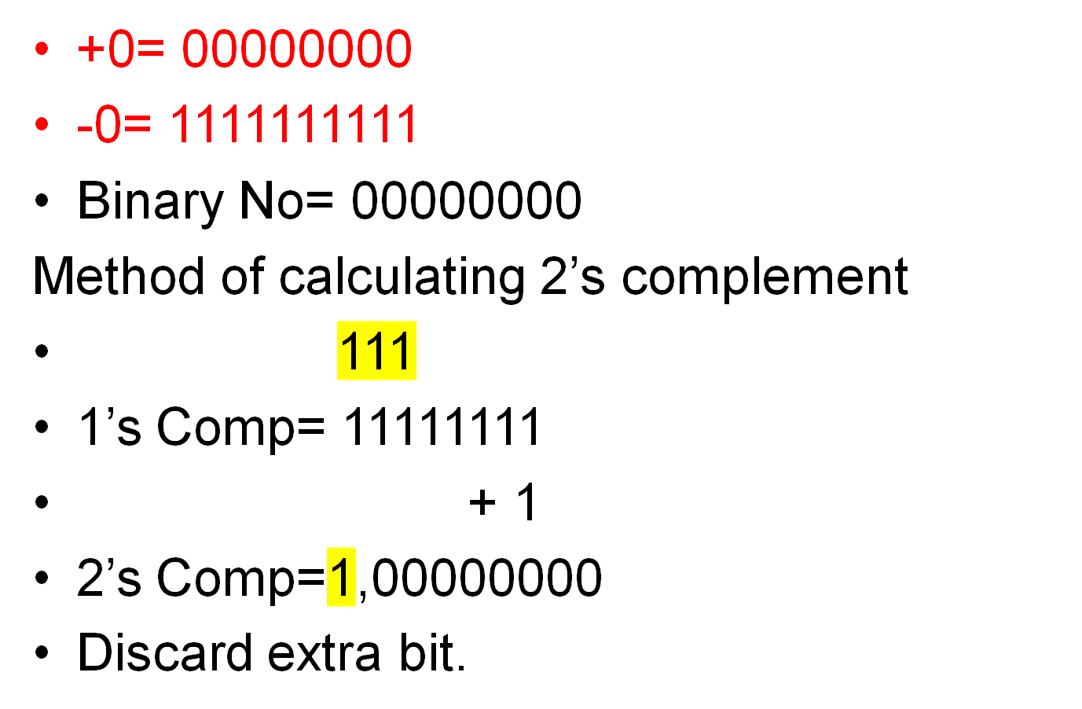
Drawback of 1’s Comp

Slide 62
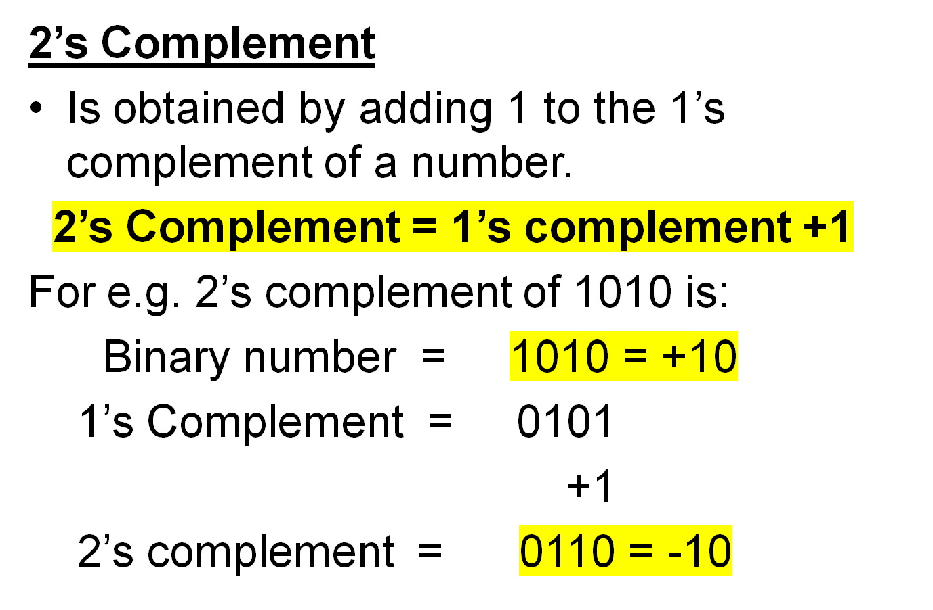

Slide 63
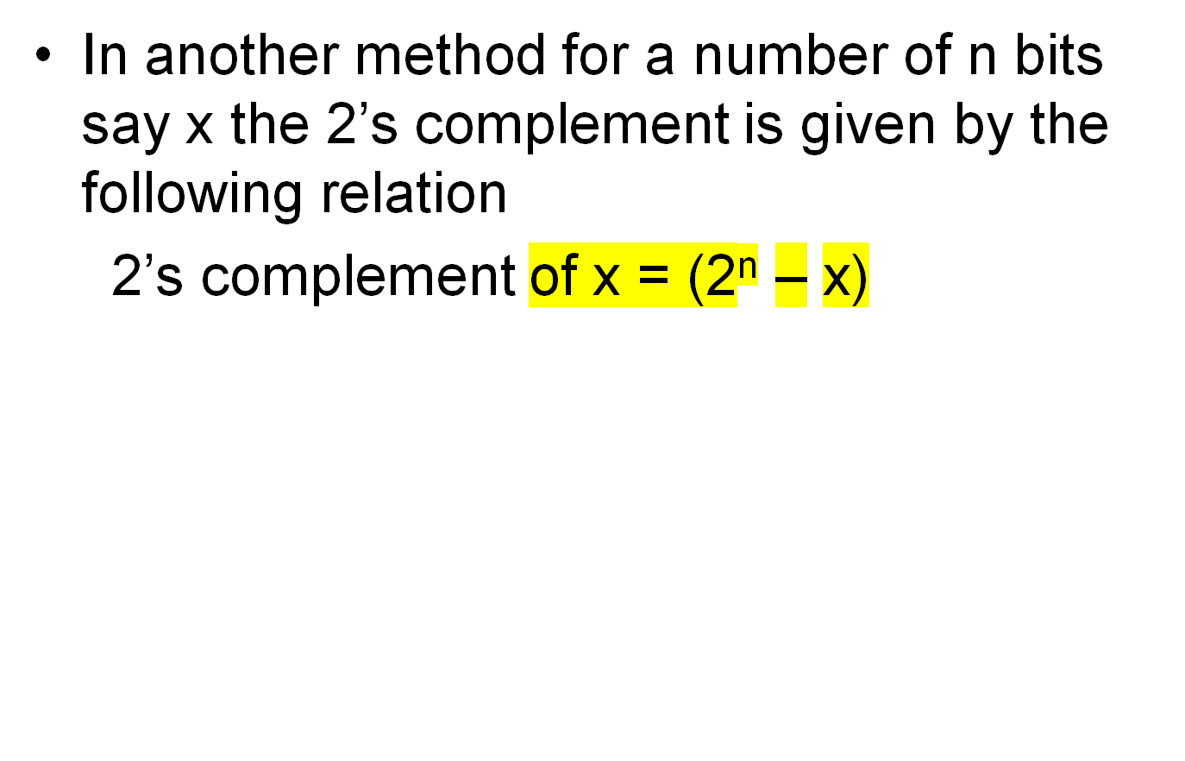

Slide 64
Addition & Subtraction in 2’s Complement
Add +9 and +8 using 2’s complement
Add +9 and -8 using 2’s complement
+9 = 0 0001001
-8 = 1 1111000
Sum = 1 0000001
ignore this carry
Or = 0 0000001

Slide 65
Add +128 and -130
+128 = 1000 0000
-130 = 0111 1110
Sum = 1111 1110 = -2
To check the result convert this negative number obtained into a positive number by using 2’s complement.
For this find 2’s complement of 11111110 which is 00000010 which is 2. Thus 11111110 is equal to -2 is correct answer.

Slide 66
Using 1’s comp & 2’s Complement
9 + 10
-9 +10
9 - 10
-9 - 10

Slide 67
Floating Point Representation

Slide 68
A number having integer as well as fractional part.
For e.g. 7281.35 can be stored in a 6 bit register
+ 7 2 8 1 3 5
Two problems arises by this method:
1.) Can not express very large numbers.
2.) Assumed decimal has to be remembered.
Due to these limitations we do not use this
Representation and make use of Floating
Point Representation.
DECIMAL POINT (Assumed)

Slide 69
1.) .0023567 x 10⁴
2.) .00000634
.634 x 10⁻⁵
3.) -3456.6778
-.34566778 x 10⁴

Slide 70
The floating point representation of a number has two parts:
1.) First, part represents a signed, fixed point number called the mantissa.
2.) Second, part designates the position of the decimal point and is called the exponent (power of 10 multiplying the fraction).
For e.g. decimal number +6132. 789 is represented as:
Fraction Exponent
+0.6132789 +04

Slide 71
The value of exponent indicates that the actual position of the decimal point is four positions to the right of the indicated decimal point in the fraction.
This will represent as +0.6132789 x 10⁺⁴
Floating points are always represent as
m x r^{e}
If we have .000349 then we can express it as +.349 x 10⁻³

Slide 72
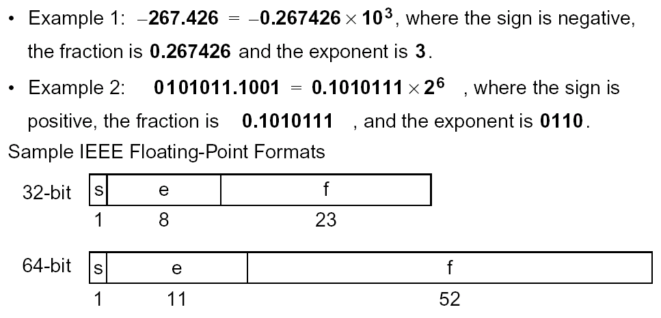

Slide 73
A Floating point Binary number is represented as
m x 2e
For e.g. binary number +1001.11 is represented with an 8-bit fraction and 6-bit exponent as:
+(.100111)₂ x 2⁺⁴

Slide 74
Normalized Floating point Numbers
A floating point number is said to be normalized if the most significant digit of the mantissa is nonzero.
For e.g. decimal number .350 is normalized but .0035 is not.

Slide 75
Character Codes

Slide 76
Coding is a technique by which a set of objects is represented in a machine by a set of binary numbers called codes.
In coding process each alphabet, special character or numeral is coded in a unique combination of 0 s & 1 s.
Codes are also used for error detection & correction i.e. to check whether a character transmitted in the coded form is correctly received if not then to correct it.

Slide 77
Codes can be broadly classified into following five groups:
Weighted Binary Codes
Non-weighted Codes
Alphanumeric Codes
Error-detecting Codes
Error-correcting Codes

Slide 78
What is ASCII?
ASCII is the American Standard Code for Information Interchange, is a character encoding based on the English alphabet.
ASCII codes represent text in computers.
ASCII is quite elegant in the way it represents characters, and it is very easy to write code to manipulate upper/lowercase and check for valid data ranges.
ASCII is essentially a 7-bit code which allows the 8th most significant bit (MSB) to be used for error checking.

Slide 79
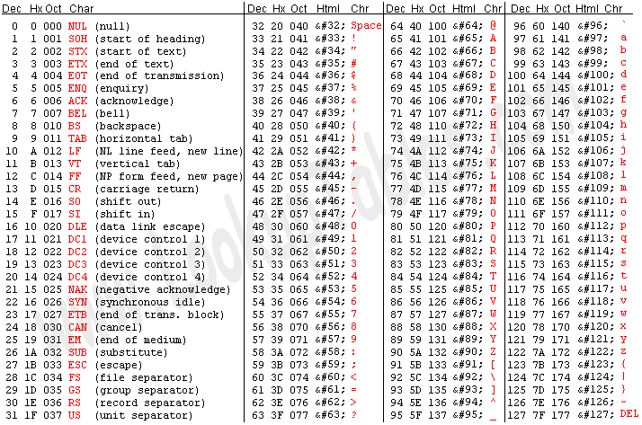

Slide 80
What is EBCDIC?
EBCDIC (Extended Binary Coded Decimal Interchange Code) is a character encoding set used by IBM mainframes.
EBCDIC uses the full 8 bits available to it, so parity checking cannot be used on an 8 bit system. Also, EBCDIC has a wider range of control characters than ASCII.

